Slide 1
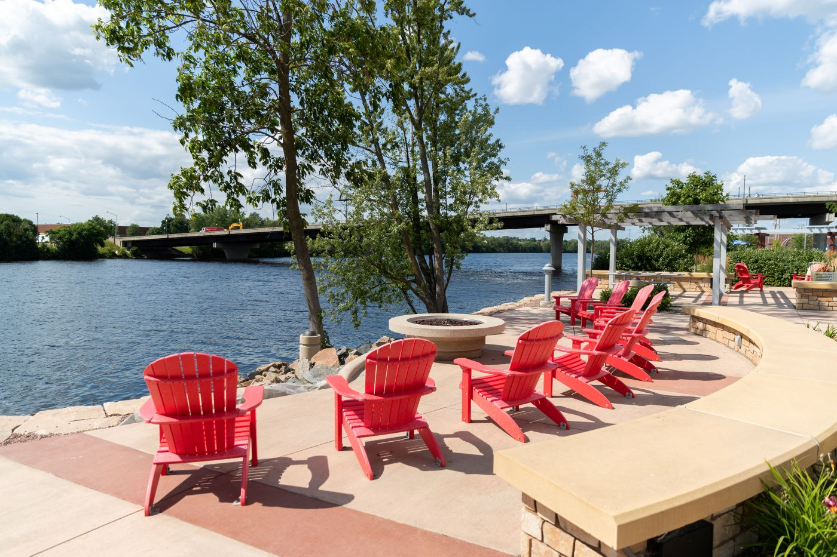


Community Development Department
The How Behind
CDBG Project Selection
February 4, 2026

Slide 2

The Stats Behind Wausau
Population 40,000
MSA Principal City
Metro Population
138,067
Median Age 41.2
Median Income $76,185
Median Home Value
$205,500
Poverty Rate 8.91%
Northcentral WI

Slide 3

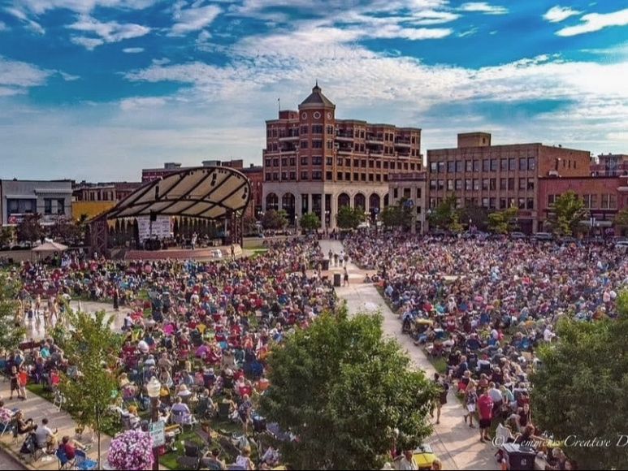
Wausau CDBG Statistics
Allocations over the past 4 years have ranged from $617,593 to $578,864
The 2025 allocation was $578,864, a 2% decrease from 2024, about $22,000 less & the lowest since 2017.
Public Service Activities: account for 10-15% of annual allocation ($86,800 for 2025).
On average, 4 to 6 Public Service Activities receive funding annually.
Internal Public Facilities are funded annually, with occasional support for external projects.
Internal Housing projects include Housing Rehabilitation & Property Acquisition

Slide 4

Citizen Advisory Committee
10 citizen members + 1 Council member
Shares priorities from the 5-Year Consolidated Plan
Provides updates on upcoming and potential projects
Encourages sharing of new local agency information
Leverages foundation connections for referrals
Council member supports advocacy and approvals

Slide 5
CDBG Application Process
Application Process
Citizen Advisory Committee sets the schedule for public hearings & the working session for next program year.
Hold at least 2 Public Hearings for citizen comments related to the CDBG program; receive applicant’s proposals.
Provide committee full applications to review along with scoring sheet to for evaluation.
Committee holds a “Working Session” to discuss proposals to recommend funding. Scoring sheets supports decision-making.
Present funding recommendations to Finance Committee & Common Council; Committee Chair attends meetings with staff.
Committee is available as needed for CDBG-related meetings or public hearings.

Slide 6
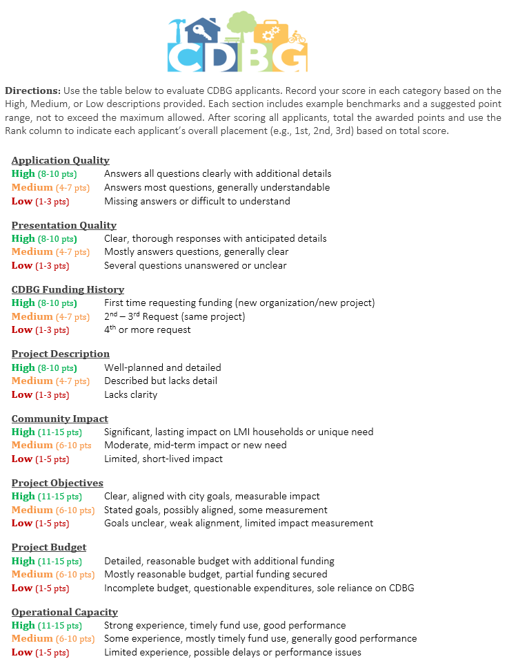
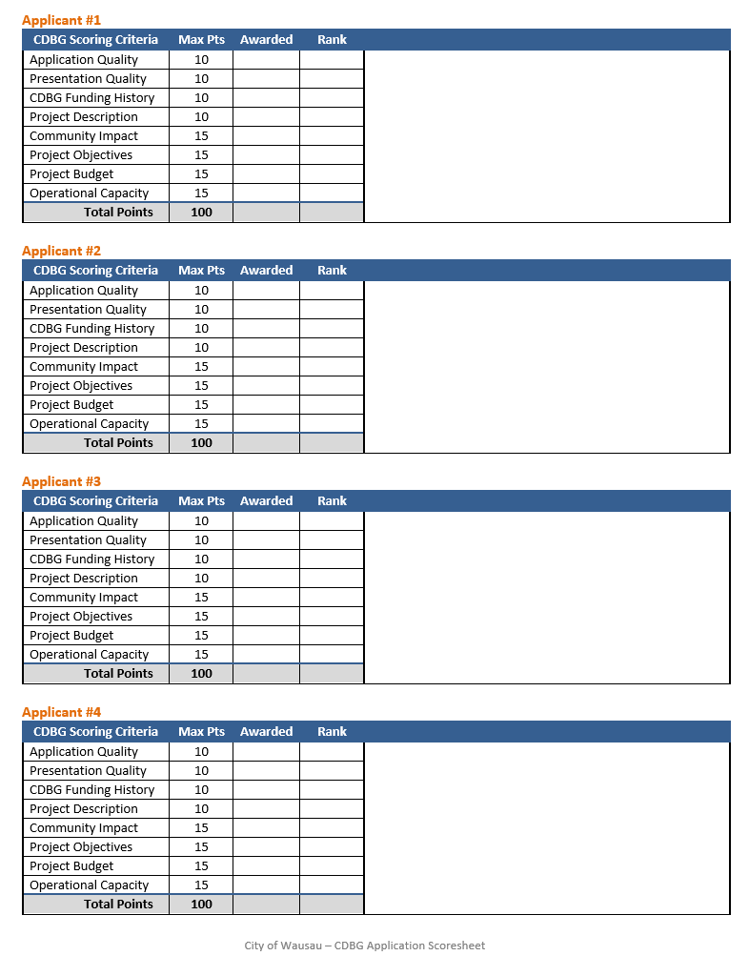
Scoring Tool for Application Evaluation

Slide 7

Pros of a Citizen Advisory Committee
Less
Political
Different Neighborhoods Represented
Less Intimidating for Applicants
Friendlier Environment

Slide 8
Cons of Citizen Advisory Committee
Maintaining full committee
membership
Lack of communication for missed meetings
Committees' perspective may
differ from City priorities
Recommendations only; final
decision rests with Council

Slide 9


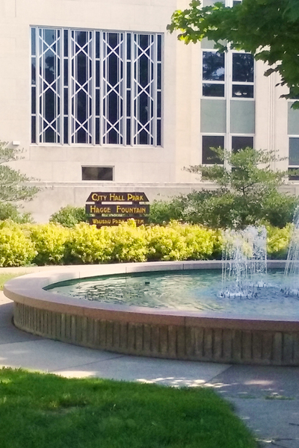
Questions
Tammy Stratz
Community Development Manager
407 Grant St. | Wausau, WI
715-261-6682
tammy.stratz@wausauwi.gov

